Slide 1
Status report #9
2019. 12. 24 (Tue)
B4 T. FUJIWARA
Beam time at ELPH
Preparation new ToF counter
Rough result

Slide 2
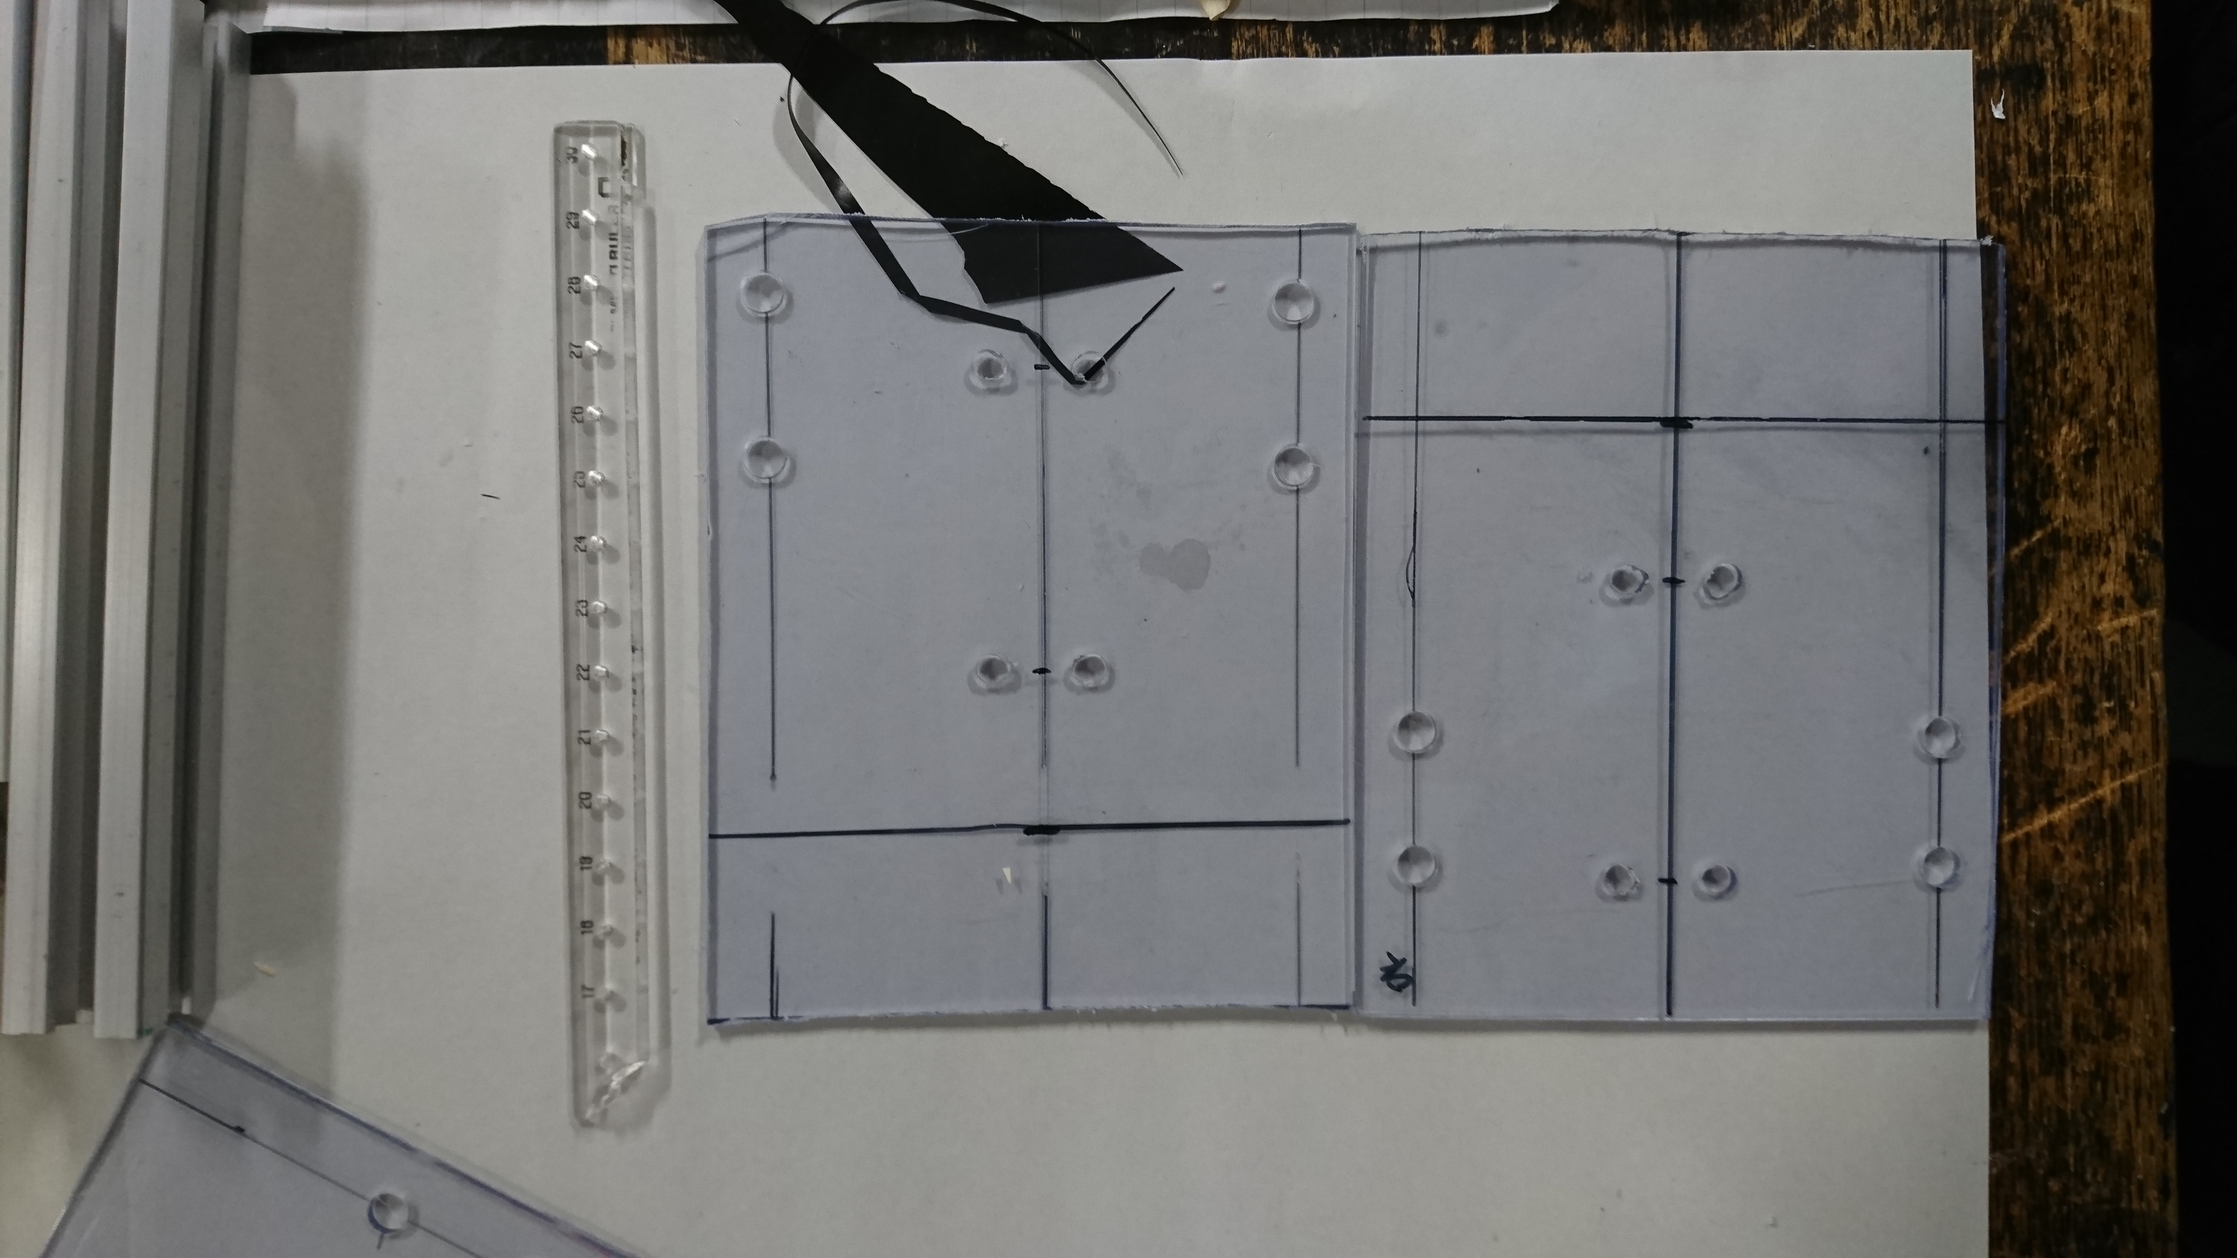
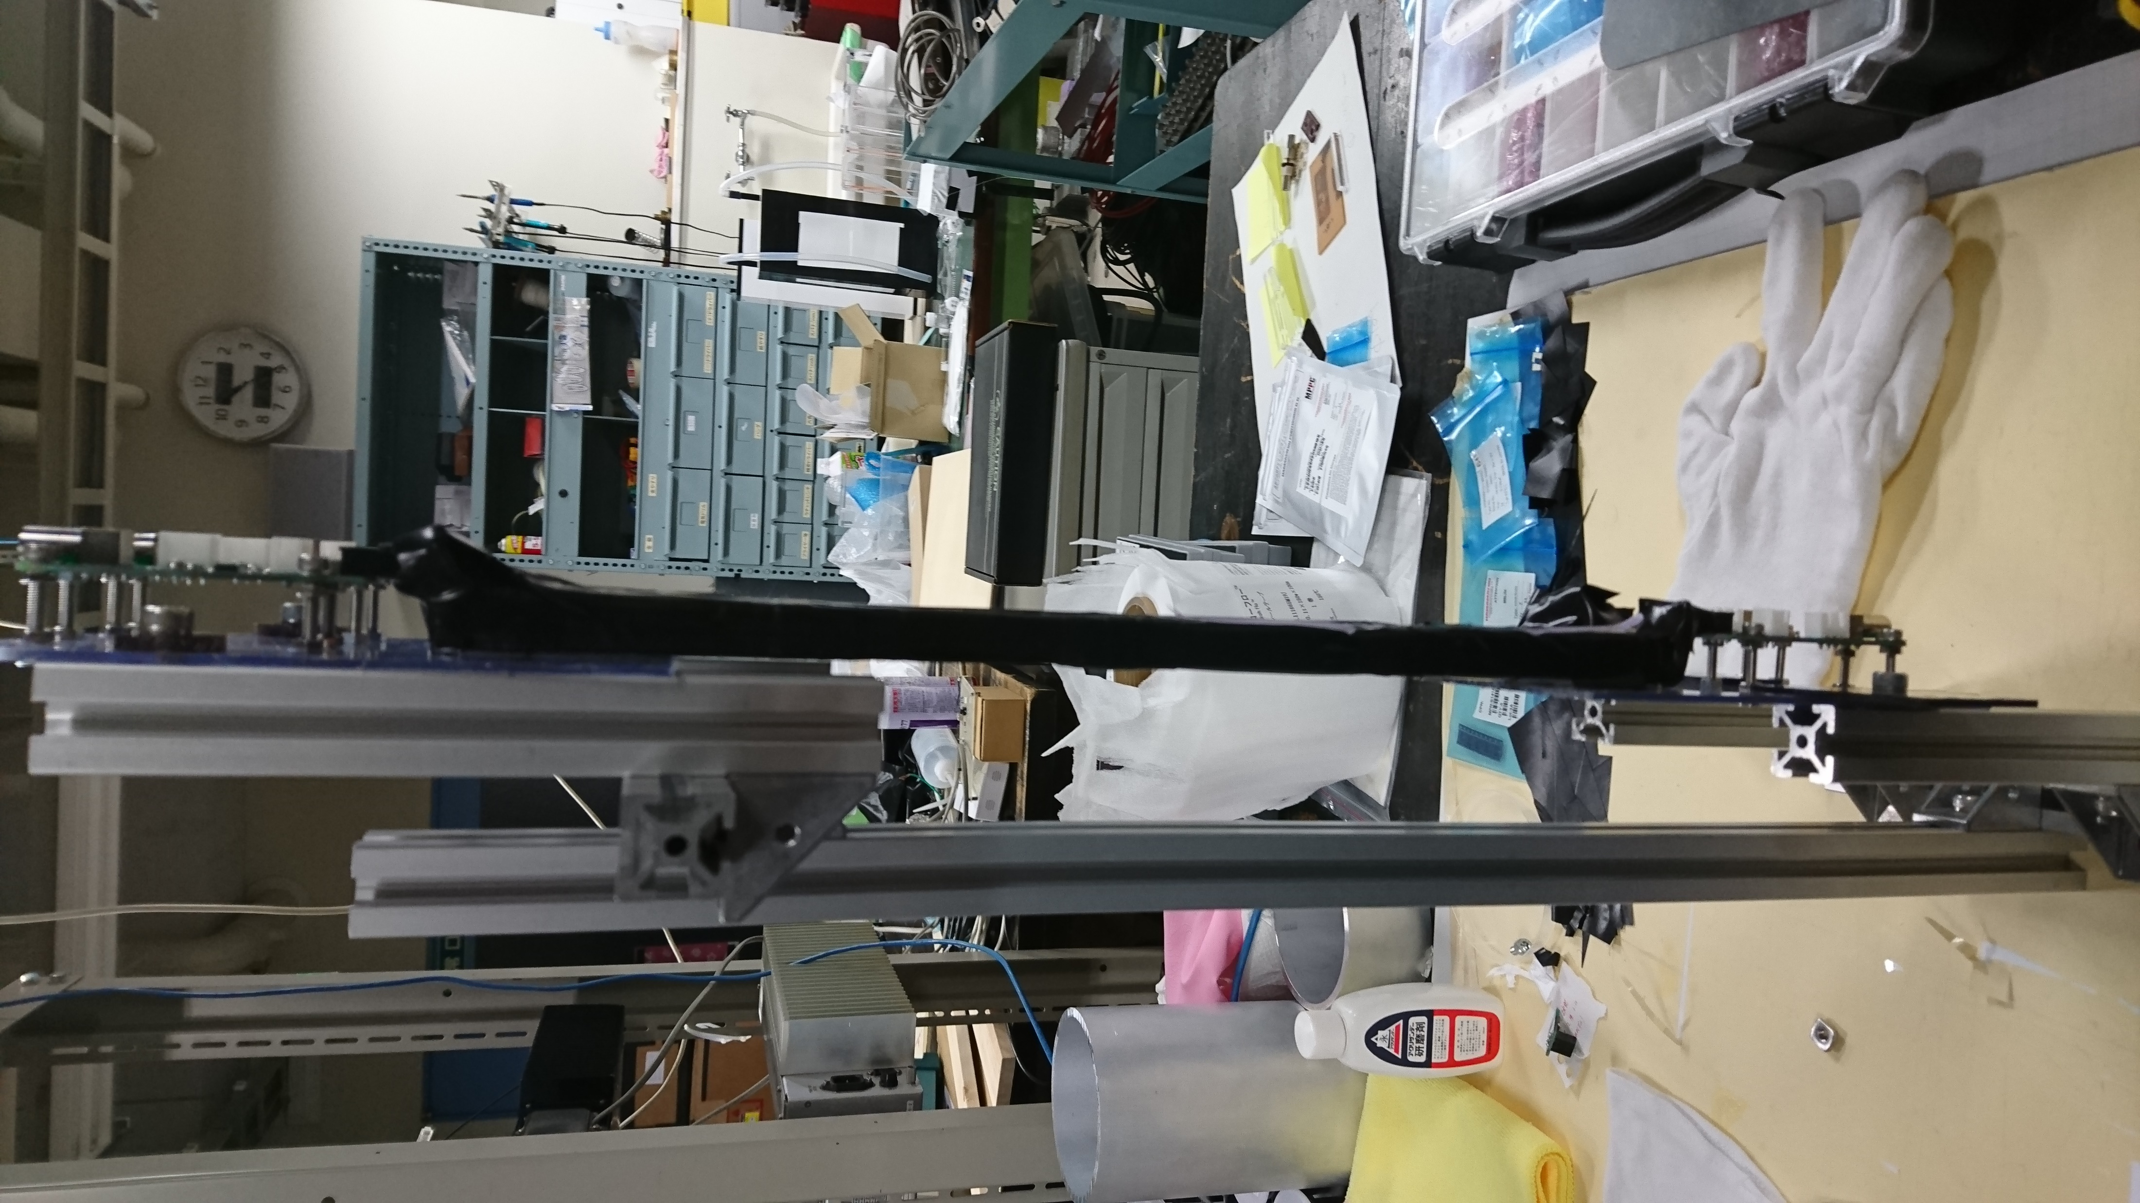
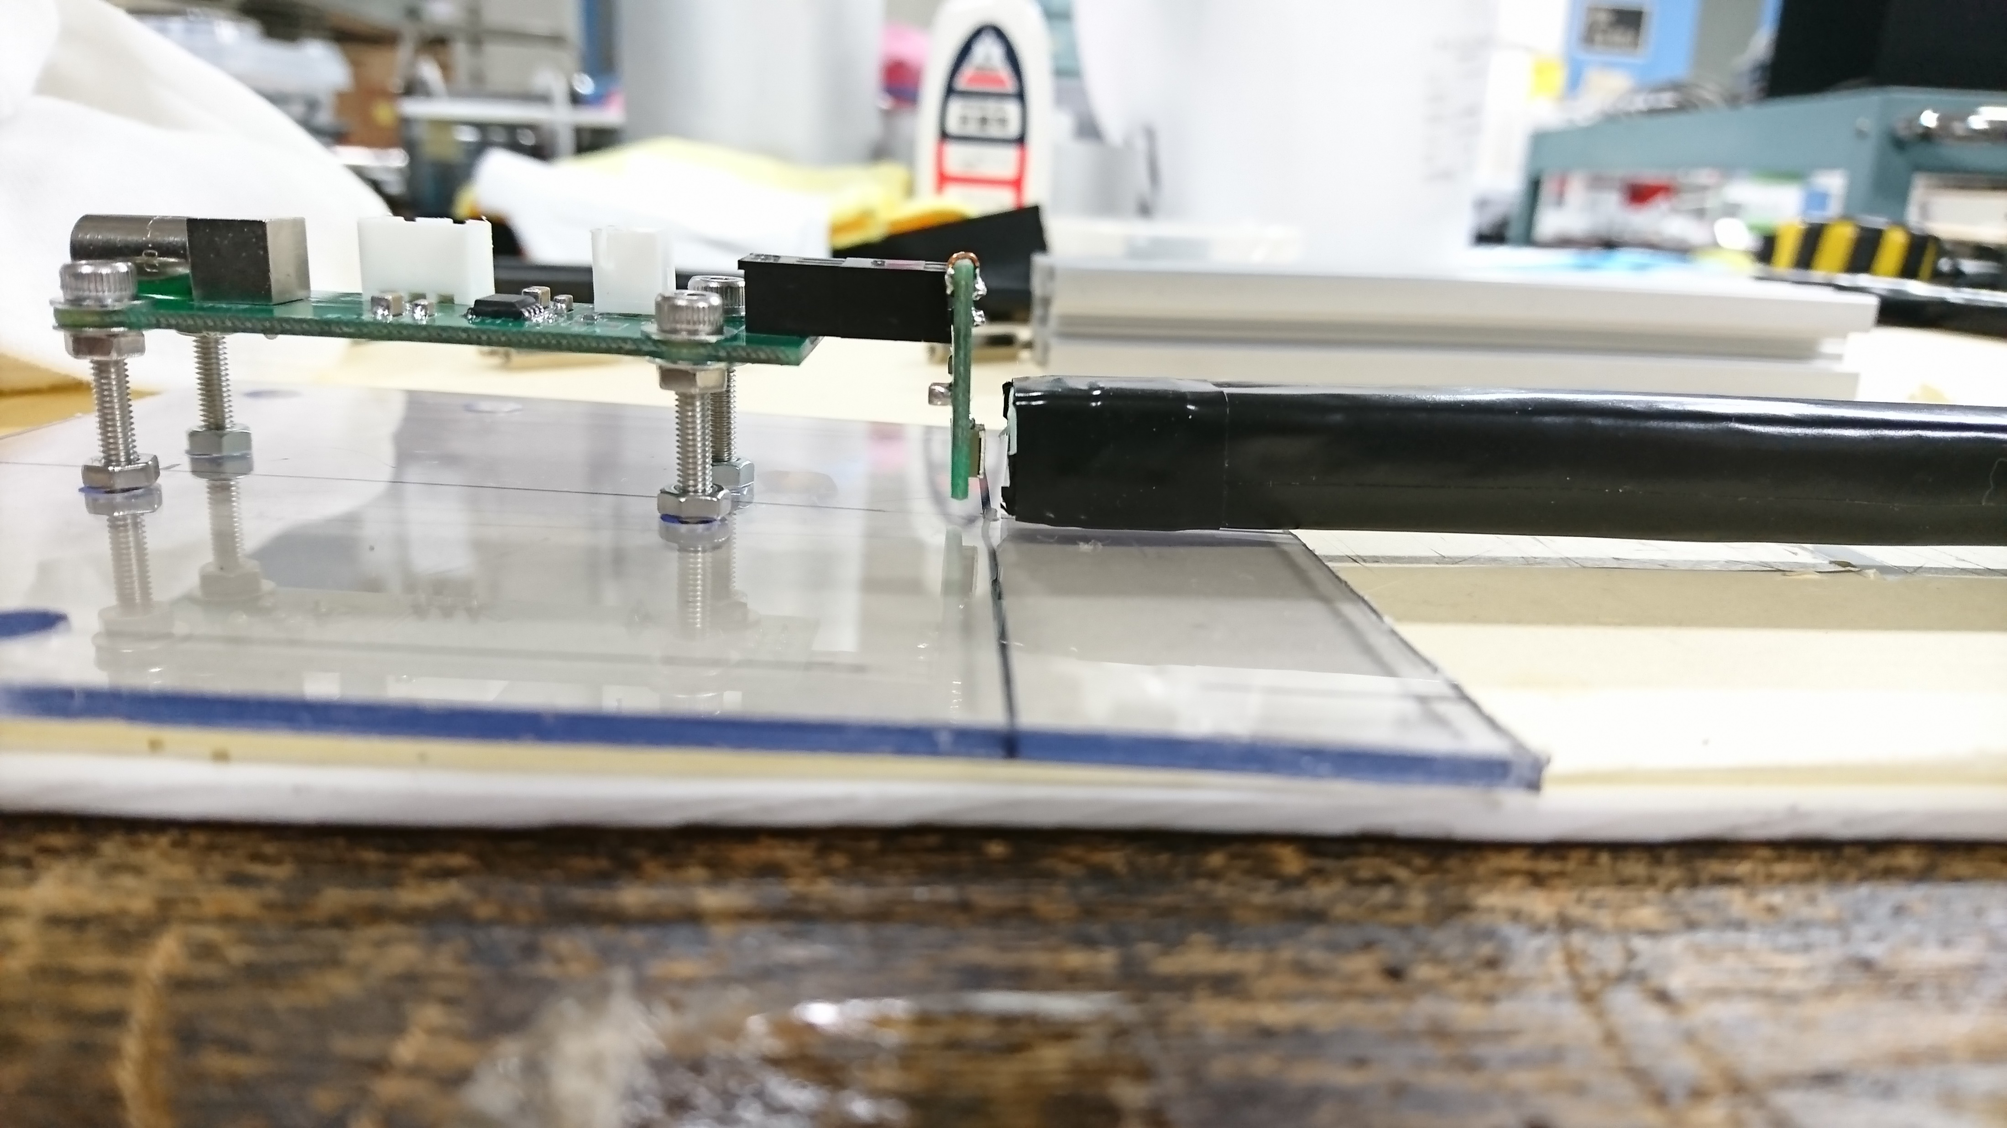
New ToF counter
Making the frame for setting ToF counter with acrylic board & aluminum frame

Slide 3
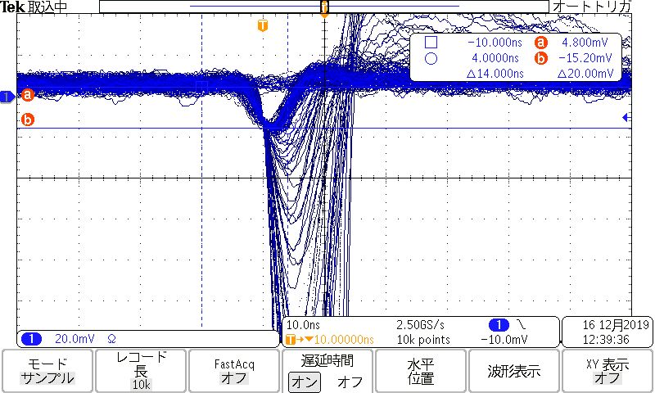
Signal of new TOF counters
ベータ線源無, PMamp + 印加電圧: V=44.7V(= Vop + 3.0V) でのsignal
TOF-R R1

Slide 4
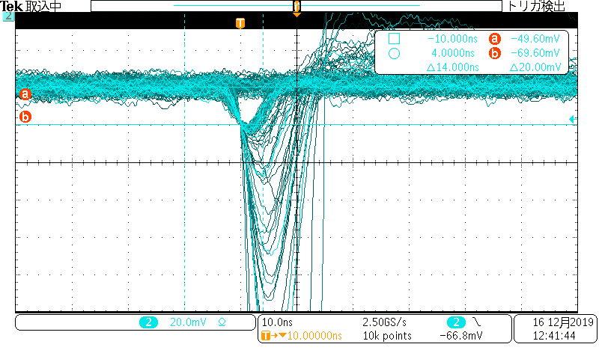
Signal of new TOF counters
ベータ線源無, PMamp + 印加電圧: V=44.7V(= Vop + 3.0V) でのsignal
TOF-R R2

Slide 5
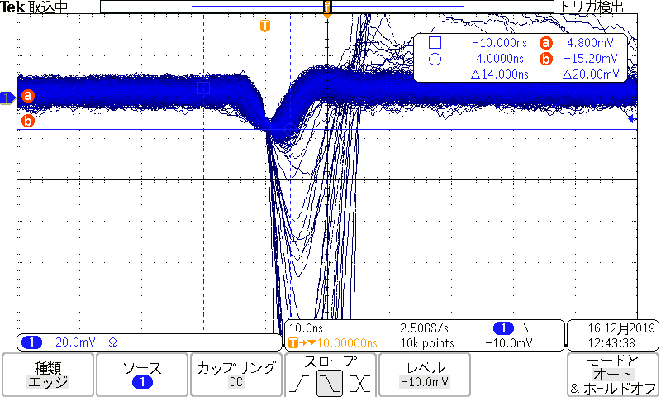
Signal of new TOF counters
ベータ線源無, PMamp + 印加電圧: V=44.7V(= Vop + 3.0V) でのsignal
TOF-L L1

Slide 6
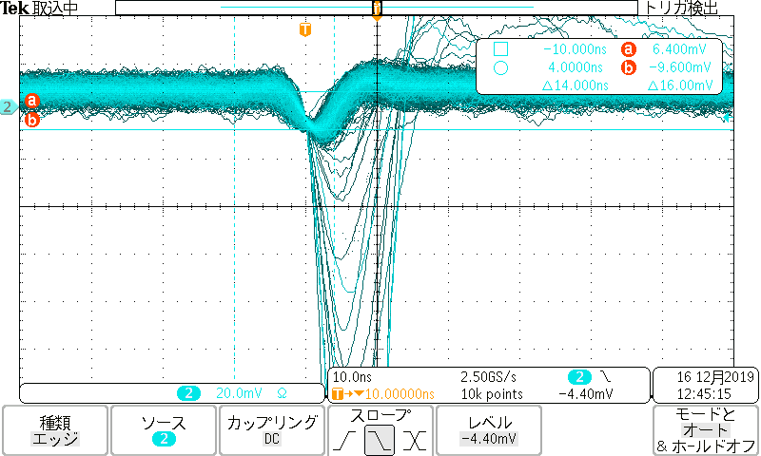
Signal of new TOF counters
ベータ線源無, PMamp + 印加電圧: V=44.7V(= Vop + 3.0V) でのsignal
TOF-L L2

Slide 7
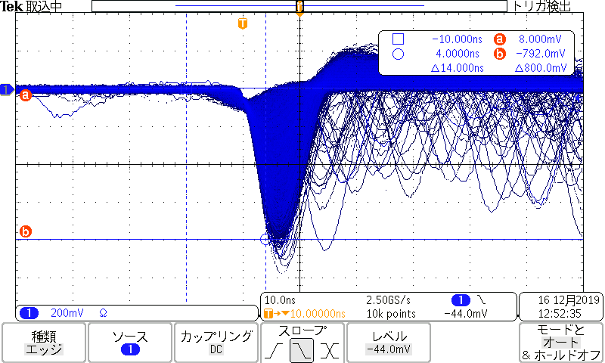
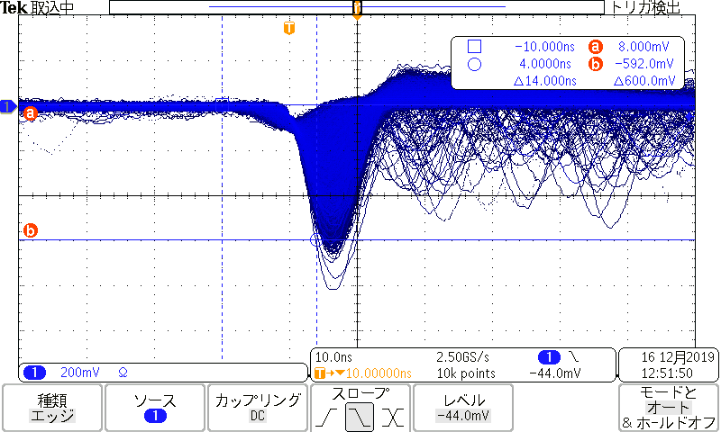
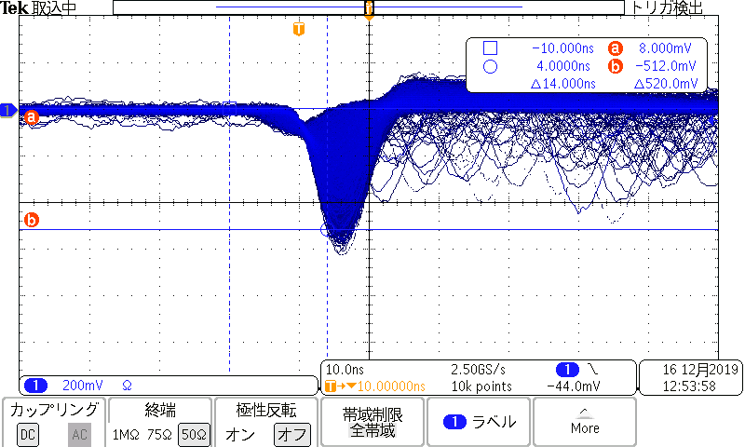
Signal of new TOF counters -1-
ベータ線源有, PMamp + 印加電圧: V=44.7V(= Vop + 3.0V) でのMIP
TOF-R R1
位置 | pulse height [mV]
center | 600
near | 800
far | 500

Slide 8
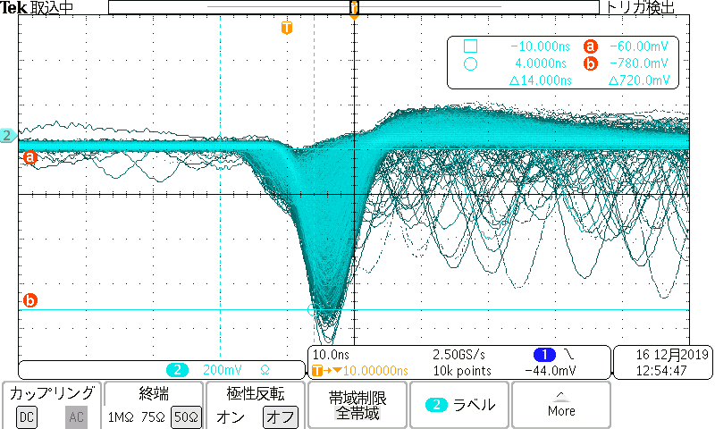
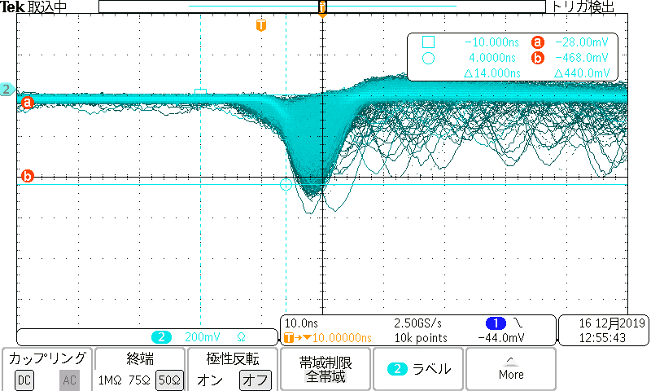
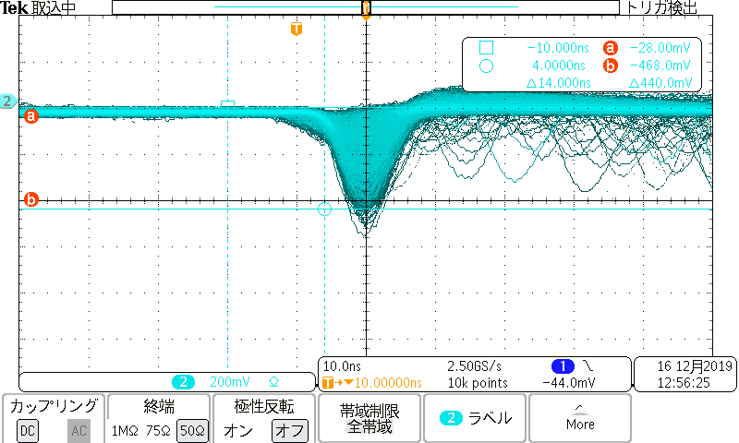
Signal of new TOF counters -2-
ベータ線源有, PMamp + 印加電圧: V=44.7V(= Vop + 3.0V) でのMIP
TOF-R R2
位置 | pulse height [mV]
center | 450
near | 700
far | 400

Slide 9
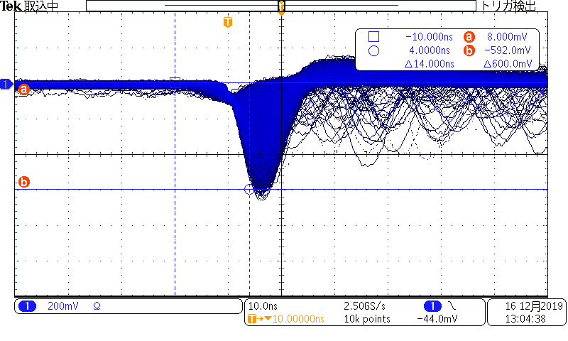
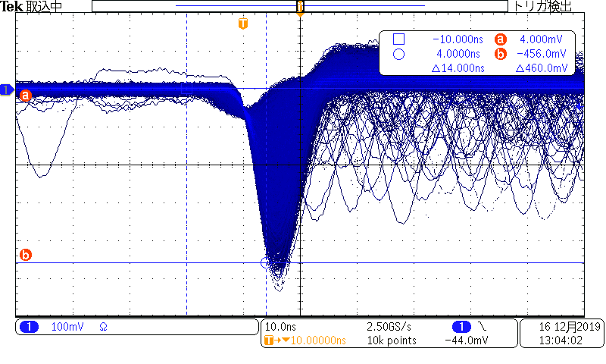
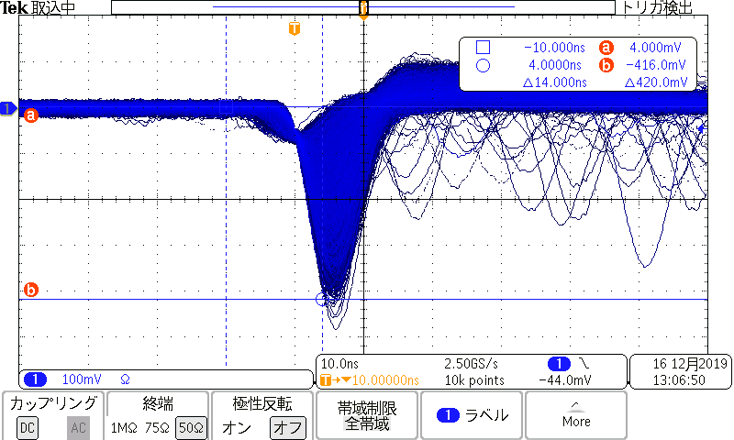
Signal of new TOF counters -3-
ベータ線源有, PMamp + 印加電圧: V=44.7V(= Vop + 3.0V) でのMIP
TOF-L L1
位置 | pulse height [mV]
center | 450
near | 600
far | 400

Slide 10
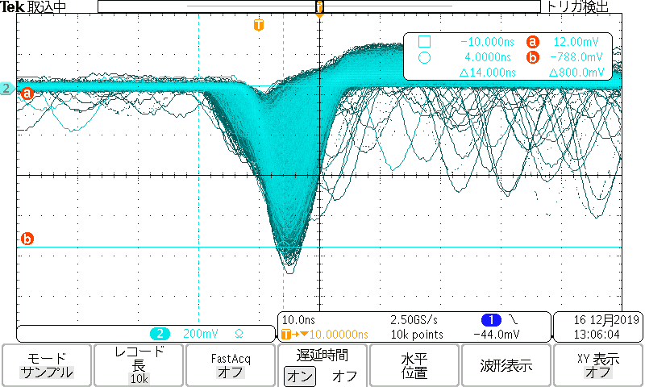
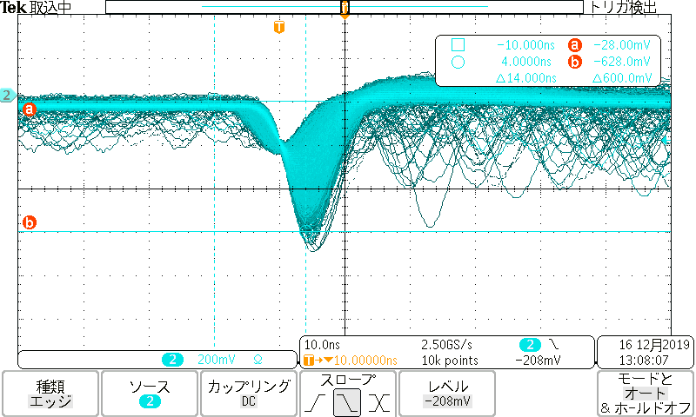
Signal of new TOF counters -4-
ベータ線源有, PMamp + 印加電圧: V=44.7V(= Vop + 3.0V) でのMIP
TOF-L L2
位置 | pulse height [mV]
center | 600
near | 800
far | 500

Slide 11
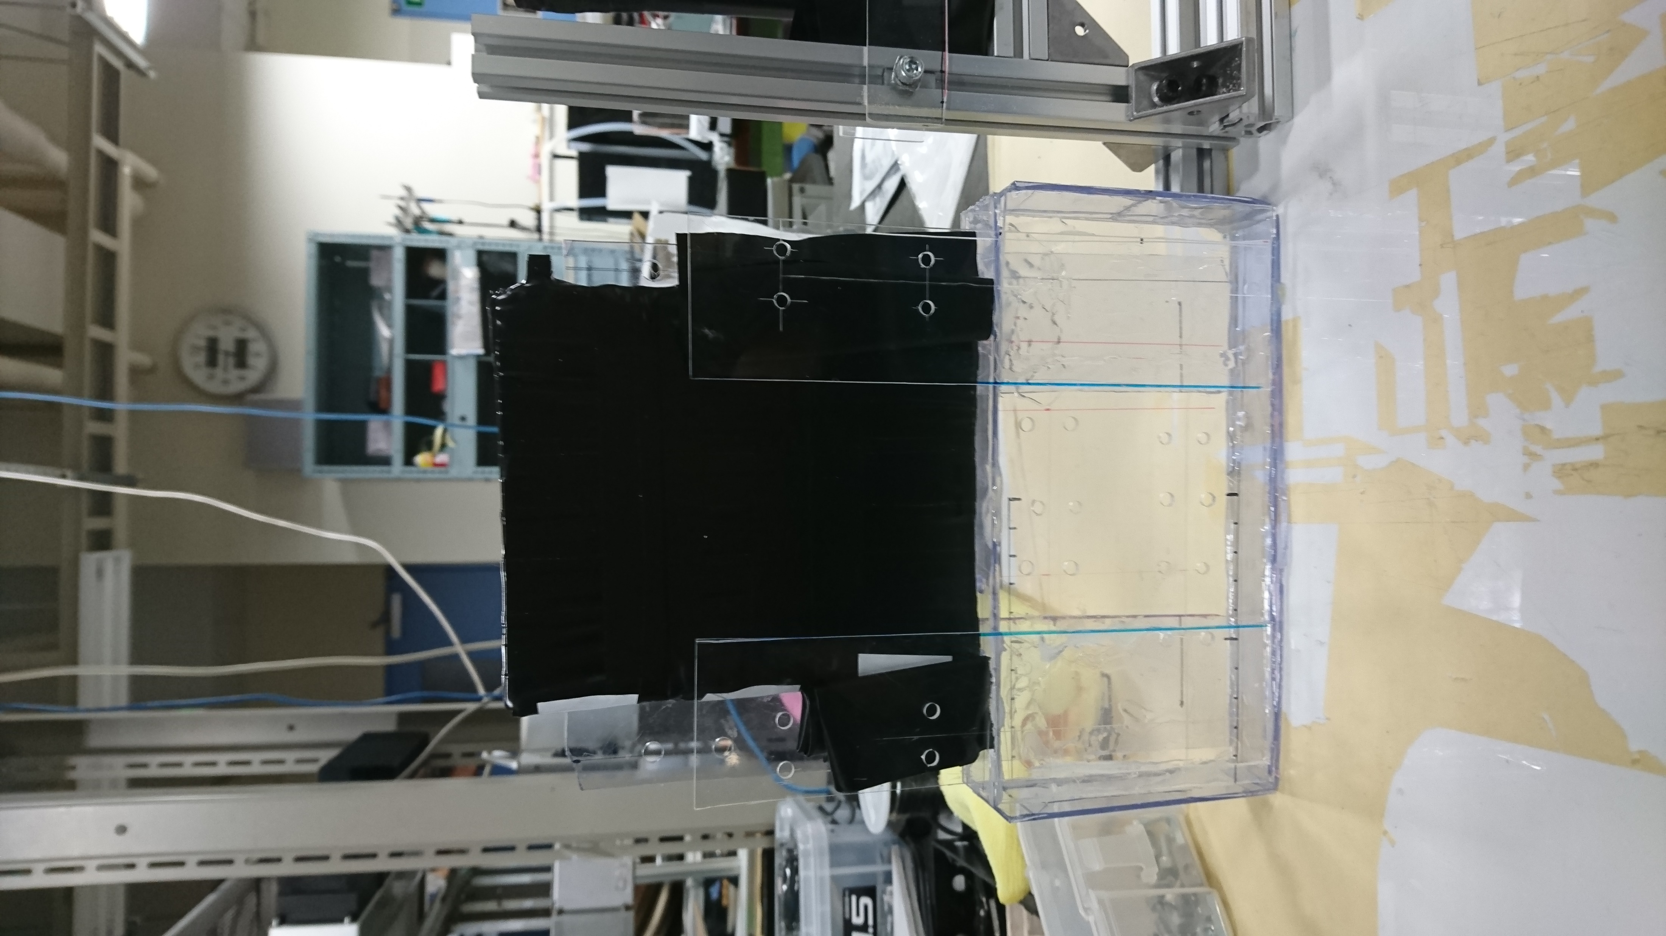
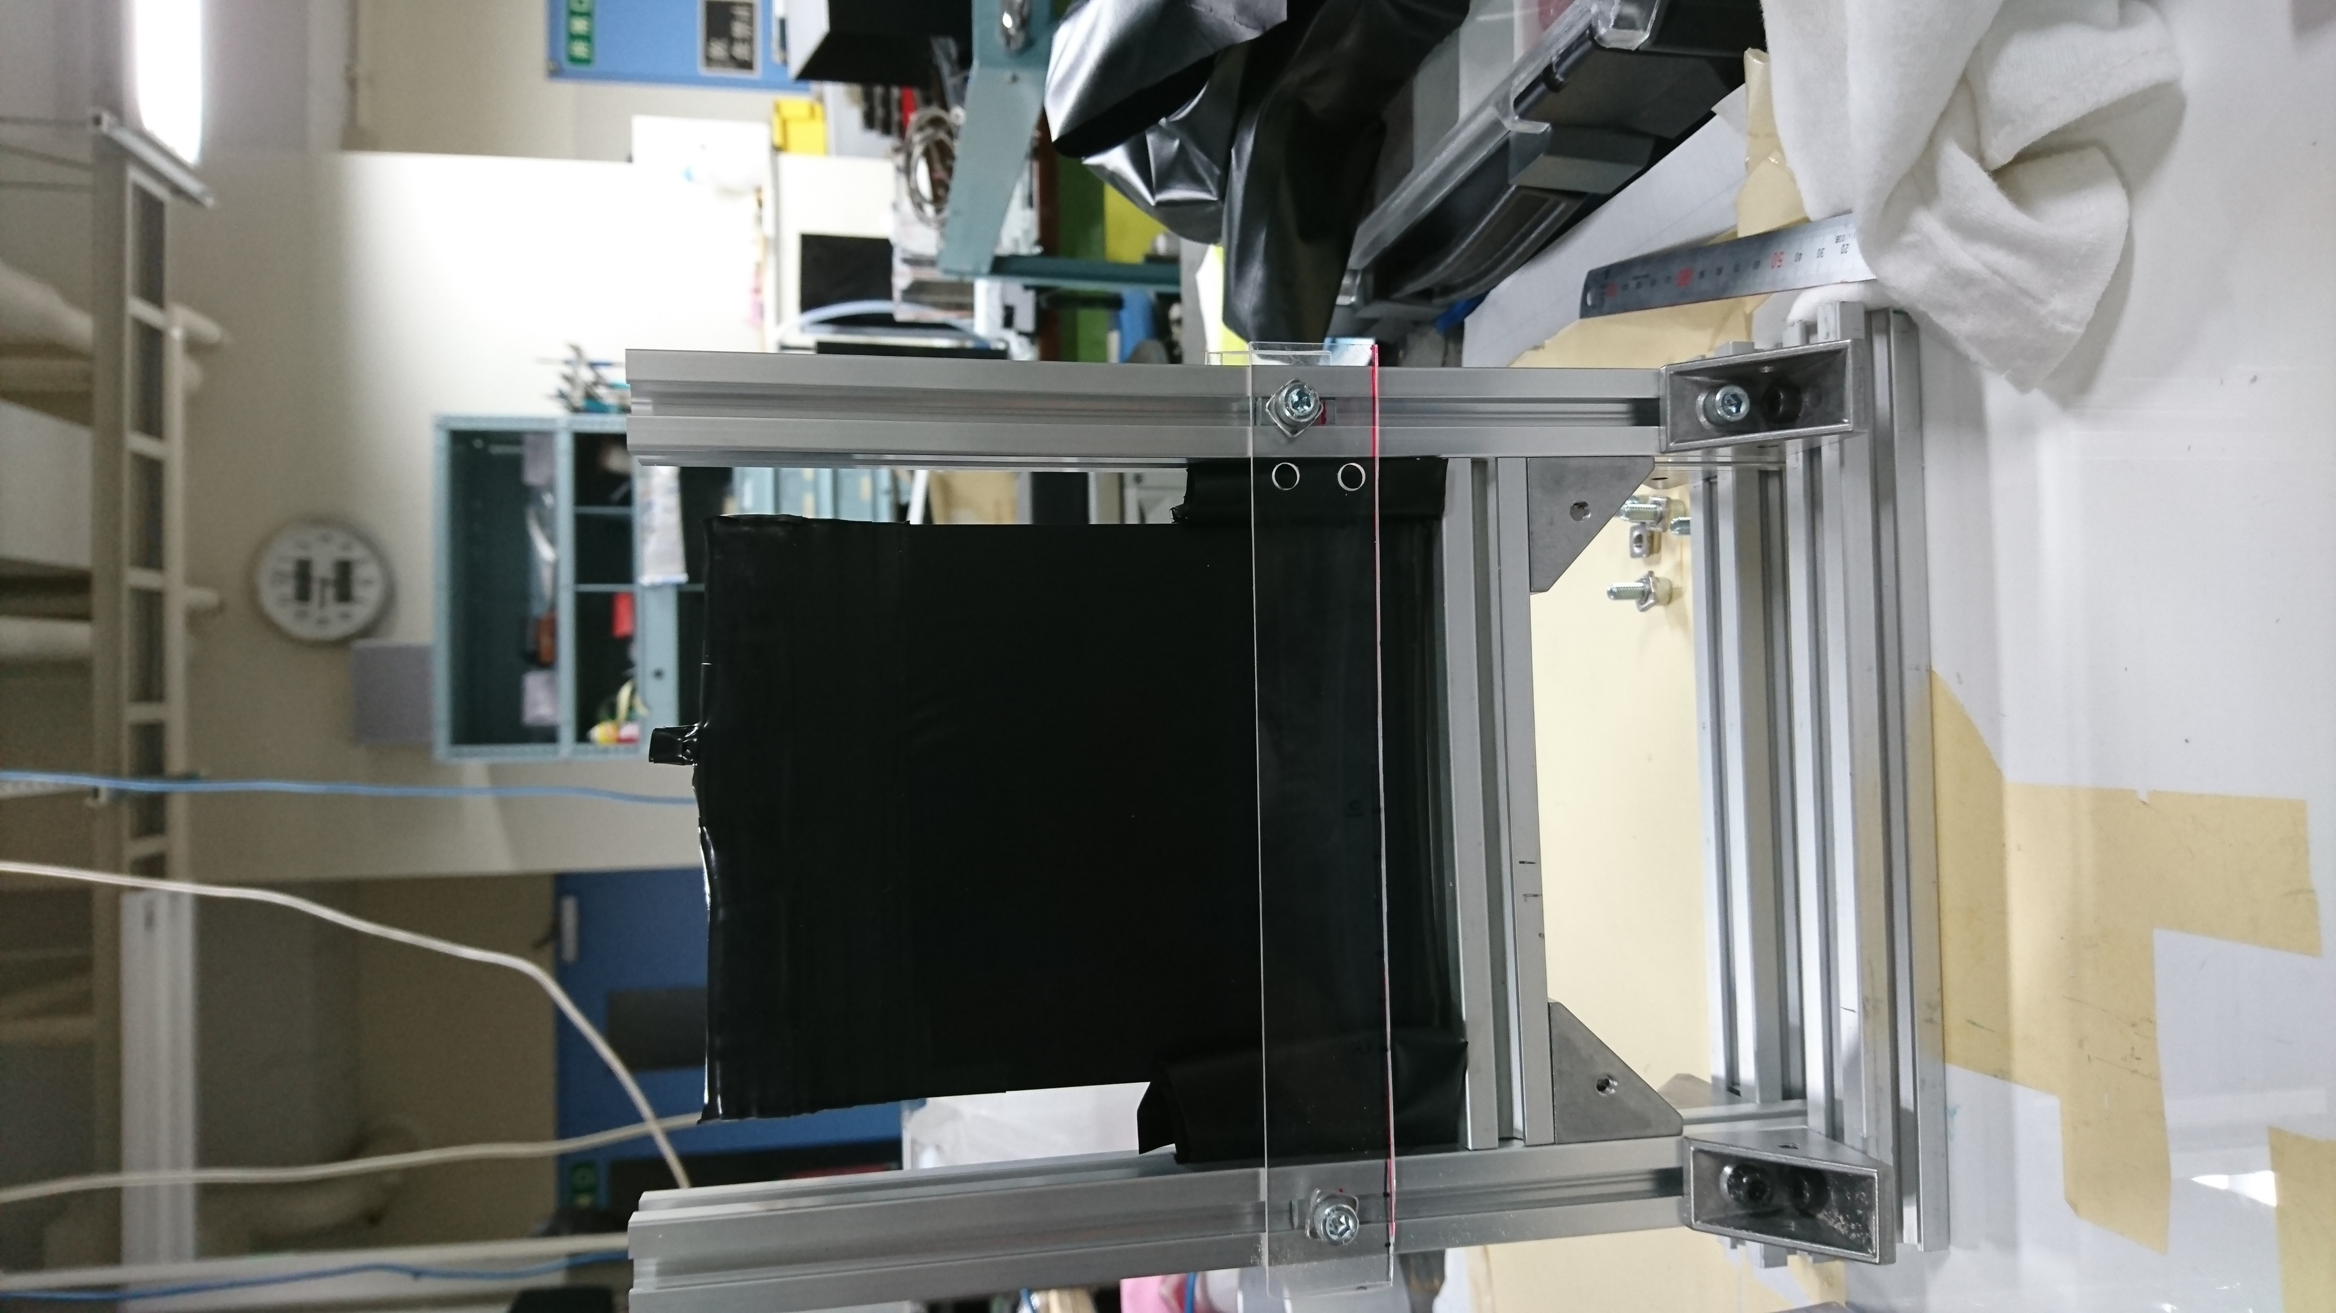
Making T1s & T2 frame
T1 : acrylic board, use only ~3cm length direction of beam
T2: aluminum frame ~5cm

Slide 12
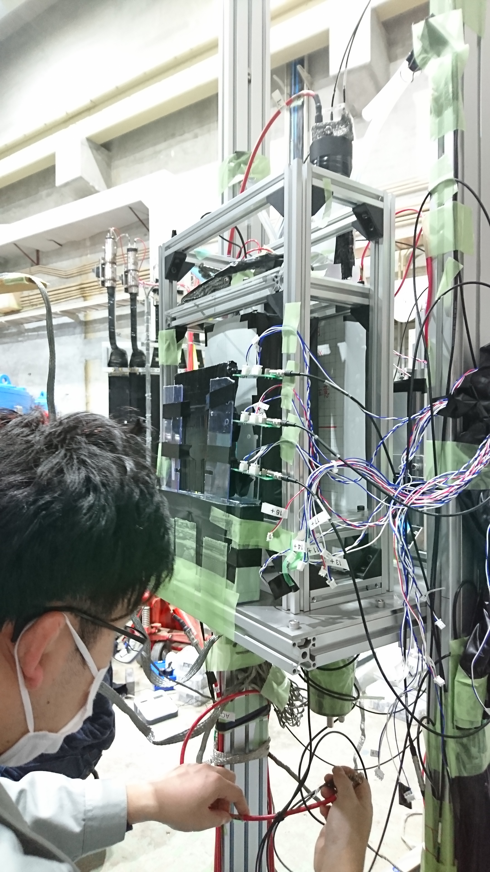
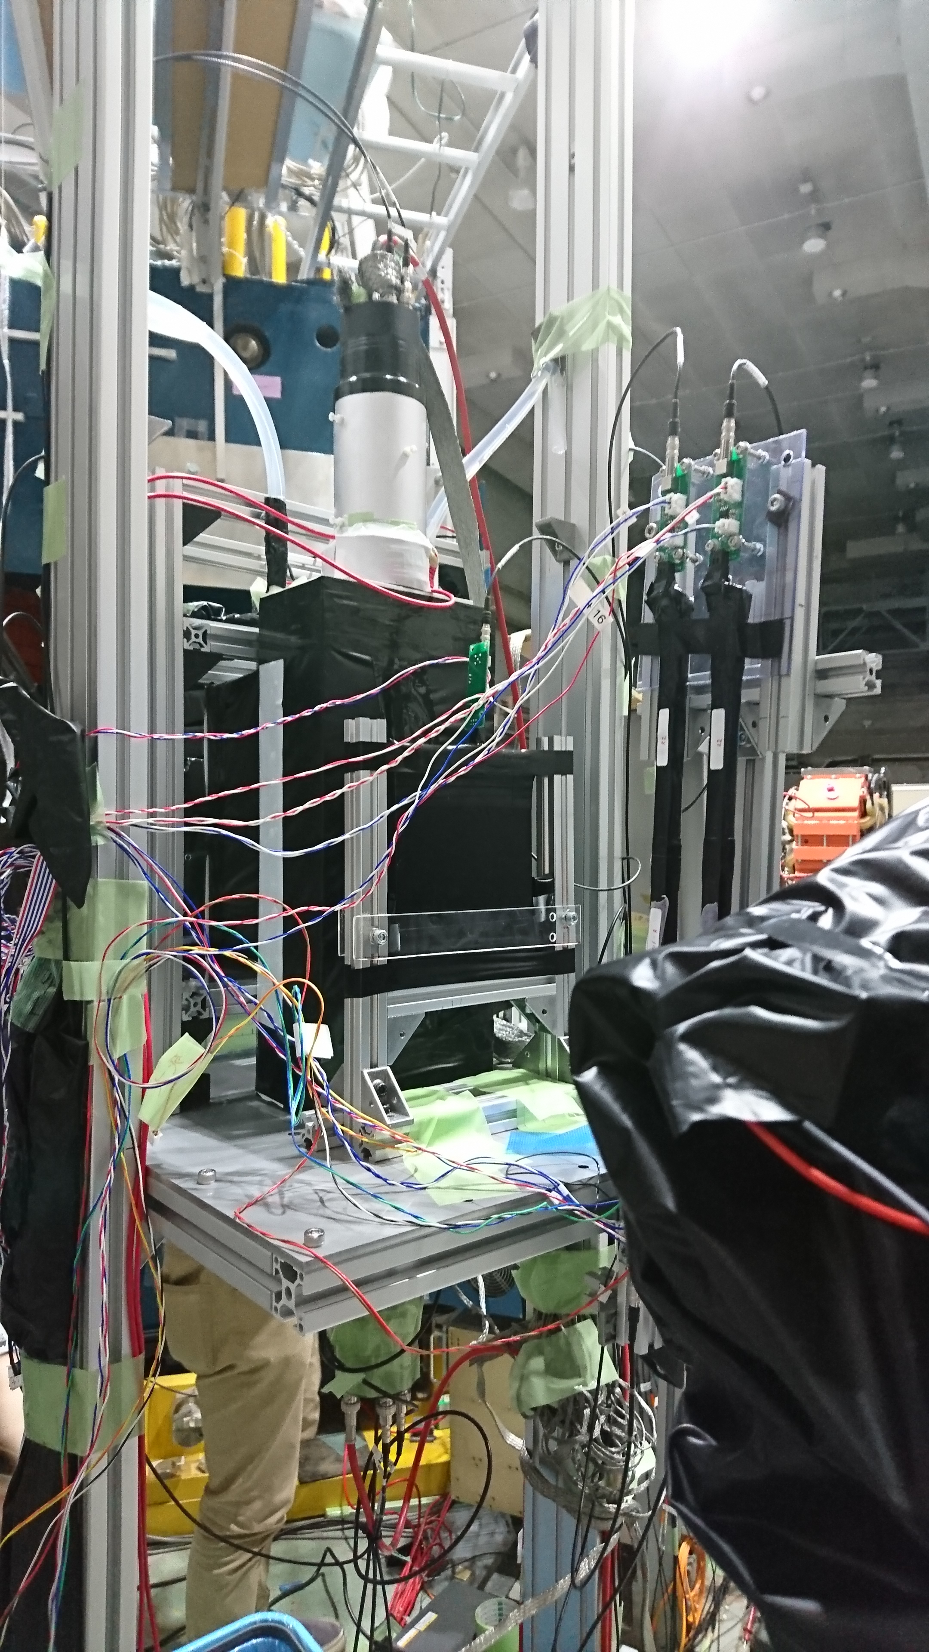
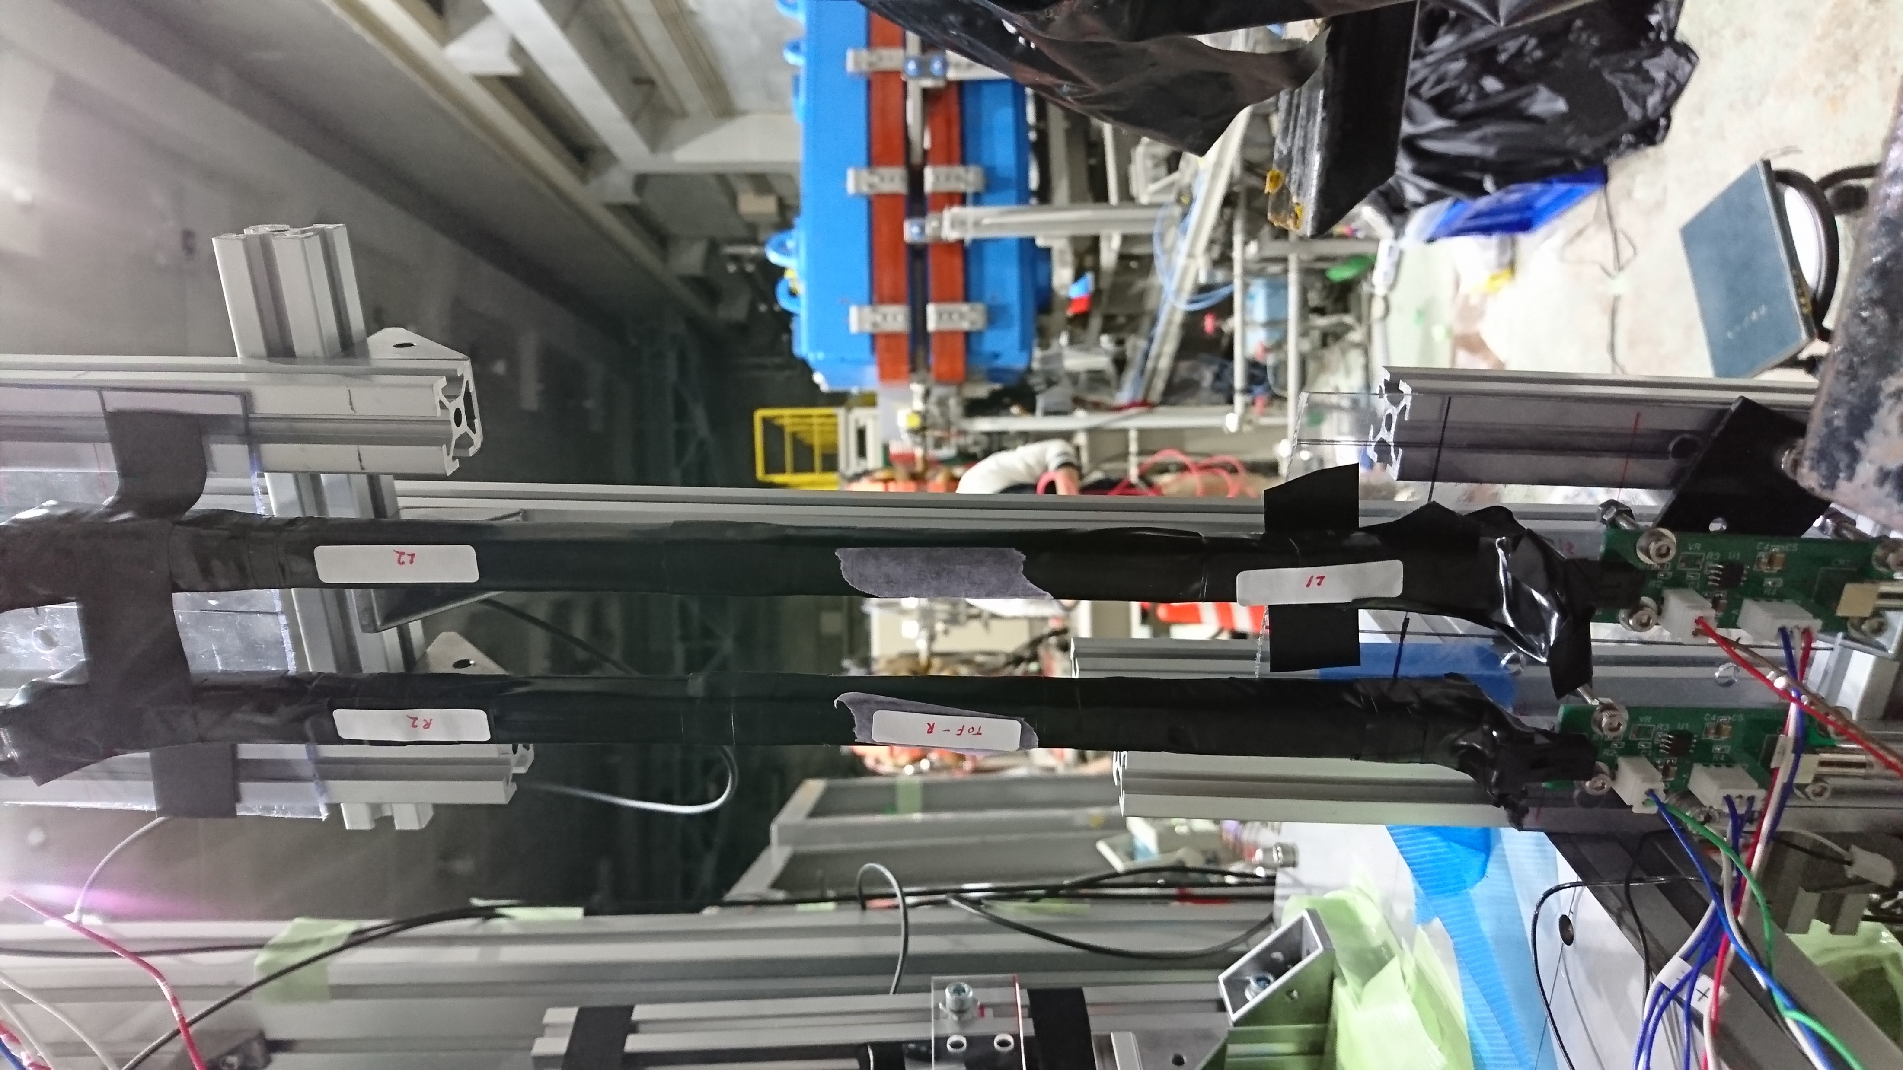
At ELPH
Setting on the frame with other detectors
R2
L2
R1
L1

Slide 13
Taking data
Study bias voltage and threshold dependence
bias voltage: 41.7, 43.2, 43.7, 44.7, 45.7, 46.2, 47.7, 49.2, (49.7, 50.7, 51.7, 52.7, 53.7, 55.2, 56.7)
threshold: about~-30mV, ~-50mV(initial + 20), ~-100mV(initial + 70), ~-150mV(initial + 120)
Initial value [mV]: R1 : -31.4, R2: -25.0, L1: -24.5, L2: -34.7
Total : 45 points taking

Slide 14
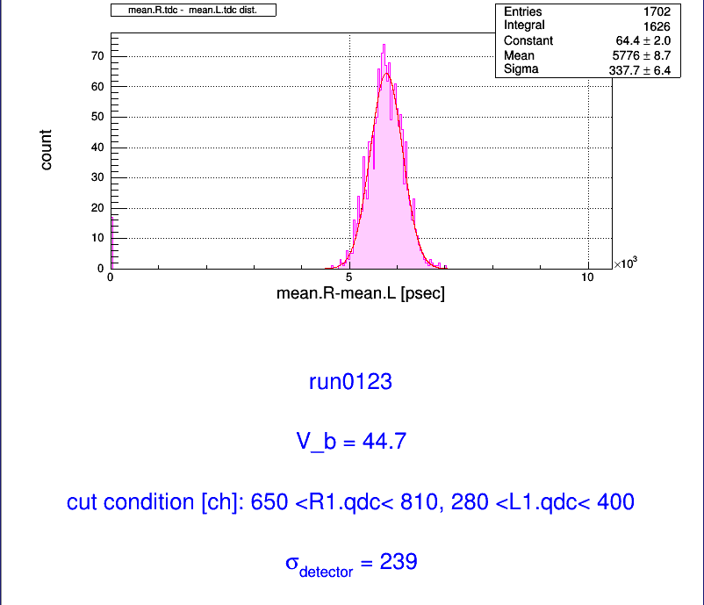
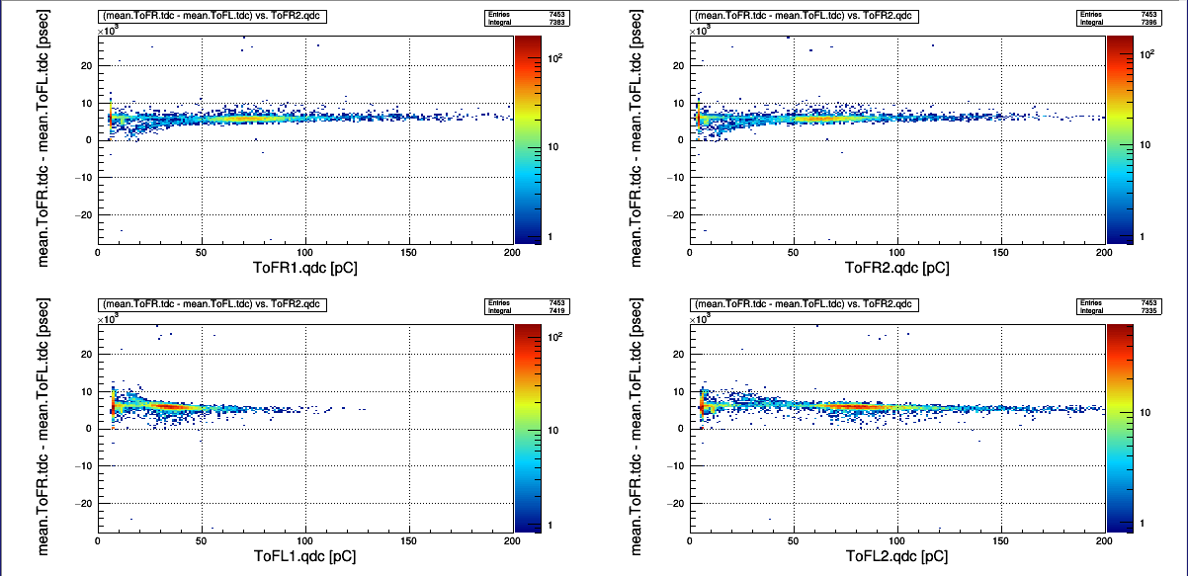
Rough result
Sorry but I have only rough result...
(forget copying figure from ELPH machine to my pc...)
For example: run0123(V=44.7, threshold ~-50mV)

Slide 15
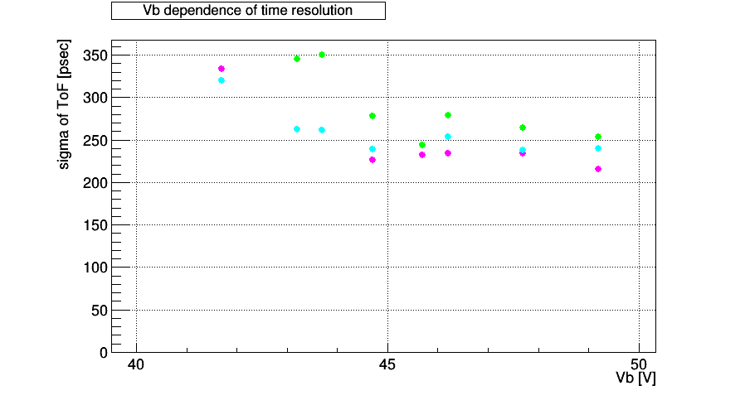
Rough result
HV dependence

Slide 16
To Do next
Data analysis → より詳細に...(time walk correction, event selection)
(Preparation for hyper nuclear seminar)
皆様，良いお年を…
Have a good year...

